Slide 1
COVID-19 VACCINE ANALYSIS OPTIMIZING DEPLOYEMENT -1
PHASE 3

Slide 2
DATA COLLECTION
On 1/1/2021 total vaccination count was 1000. people partially vaccinated is 800. In that 200 people are Fully vaccinated. On 1/2/2021 total vaccination count is 5000. people partially vaccinated is 4000. In that 1000 people are Fully vaccinated. On 1/3/2021 total vaccination count was 15000. people partially vaccinated is 12000.In that, 3000 people are Fully vaccinated. On 1/4/2021 total vaccination count was 30000. people partially vaccinated is 24000. In that, 6000 people are Fully vaccinated.

Slide 3
EXPLORATORY DATA ANALYSIS
DATE | 1/1/2021 | 1/2/2021 | 1/3/2021 | 1/4/2021
TOTAL VACCINATIONS | 1000 | 5000 | 15000 | 30000
PARTIALLY VACCINATED | 800 | 4000 | 12000 | 24000
FULLY VACCINATED | 200 | 1000 | 3000 | 6000

Slide 4
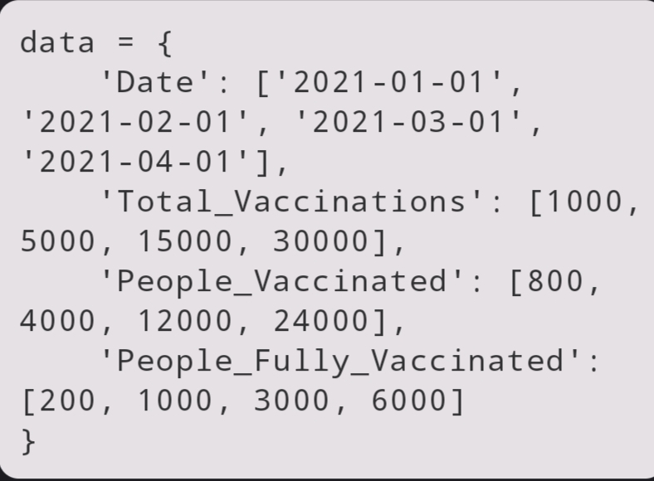
SAMPLE VACCINATION DATA
This code defines a sample dataset with columns for "Date," "Total_Vaccinations," "People_Vaccinated," and "People_Fully_Vaccinated." You would replace this with your actual dataset.

Slide 5
STATISTICAL ANALYSIS
Day by day vaccine count keeps increasing.
VACCINES COUNT IN PERCENTAGE:
1st Day: 1.9%
2nd Day: 9.8%
3rd Day: 29.4%
4th Day: 58.8%

Slide 6
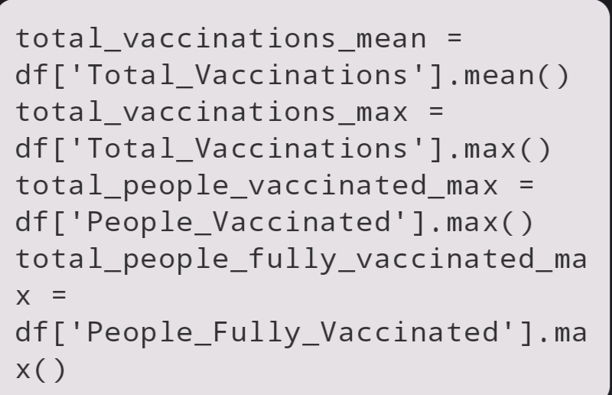
BASIC STATISTICS
Calculate basic statistics, including the mean and maximum values for various vaccination-related columns.

Slide 7
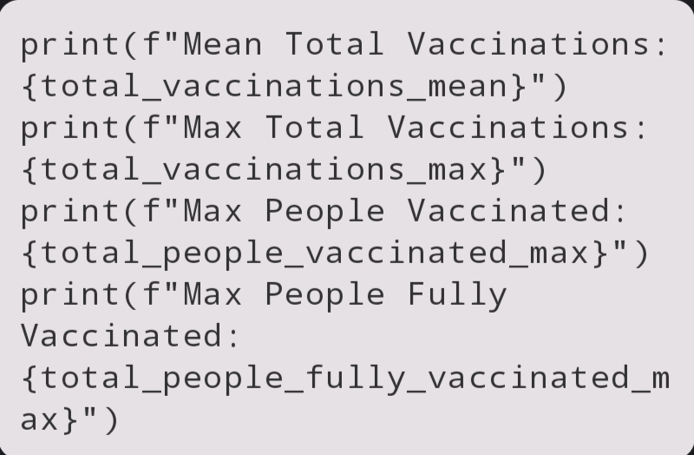
PRINT STATISTICS
Print the calculated statistics to the console.

Slide 8
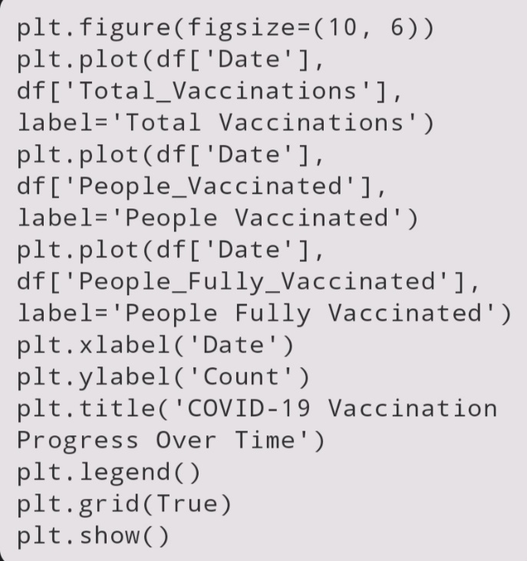
PLOT THE DATA
This code creates a line plot that visualizes the vaccination progress over time for different categories. It sets labels, titles, legends, and gridlines to make the plot informative.
Now, when you run this code, you'll get a plot showing the COVID-19 vaccination progress over time, along with basic statistics printed to the console.

Slide 9
VISUALIZATION

Slide 10
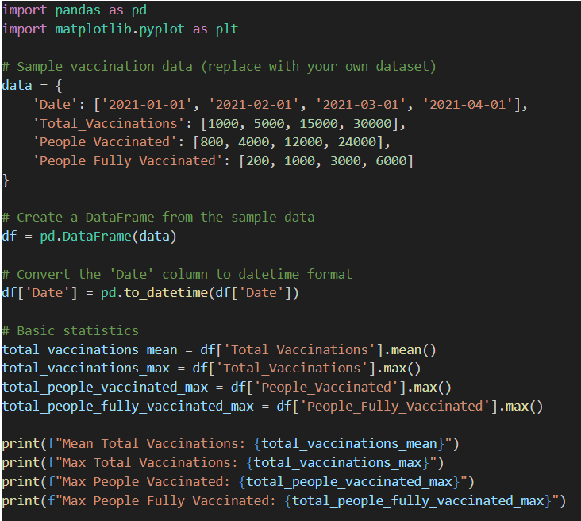
code

Slide 11
